Slide 1


Year 2020-21
Digital Communication
E-Laboratory and practicals
B.Tech. II (CSE), semester –III
By
Prof. Naresh B. Kanirkar
Prof. Mehul C. Patel Assisted by
Abhishek Tripathi
Department of Electronics Engineering
Sardar Vallabhbhai National Institute of Technology, Ichchhanath, Surat-395 007, Gujarat

Slide 2
Experiment no. -7
Objective- To Study the transmission amplitude modulated (AM) and frequency modulated (FM) signal under the Additive Gaussian noise channel (AWGN). Examine the effects of the AWGN on AM and FM signal using the Matlab/Simulink and draw the distorted waveforms for different signal to noise ratio (SNR) values.

Slide 3

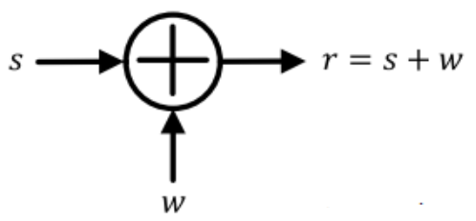
Additive white Gaussian noise (AWGN)
AWGN- A basic noise model used to mimic the effect of many random processes that occur in nature.
Channel produces Additive White Gaussian Noise (AWGN),
Additive- The received signal equals the transmit signal plus some noise, where the noise is statistically independent of the signal.

Slide 4
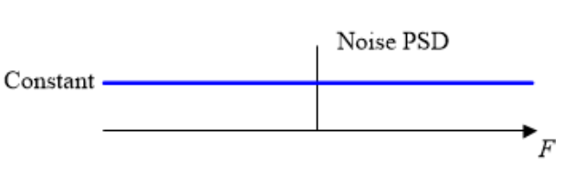
White- It refers that the noise has the same power distribution at every frequency OR it has uniform power across the frequency band for the information system.
It is an analogy to the color white which has uniform emissions at all frequencies in the visible spectrum. if I focused a beam of light for each color on the visible spectrum onto a single spot, that combination would result in a beam of white light.
As a consequence, the Power Spectral Density (PSD) of white noise is constant for all frequencies ranging from −∞ to +∞, as shown in figure below.

Slide 5
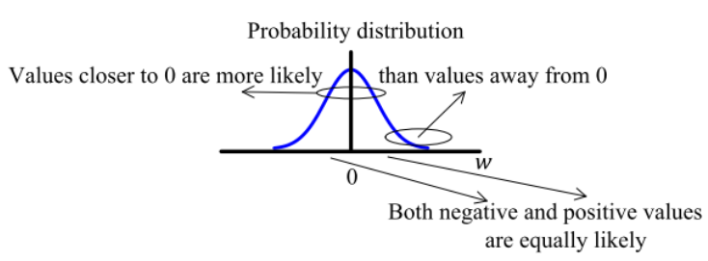
Gaussian
Gaussian- Gaussian distribution, or a normal distribution, has an average of zero in the time domain, and is represented as a bell-shaped curve.
The probability distribution of the noise samples is Gaussian with a zero mean.
The values close to zero have a higher chance of occurrence while the values far away from zero are less likely to appear.

Slide 6
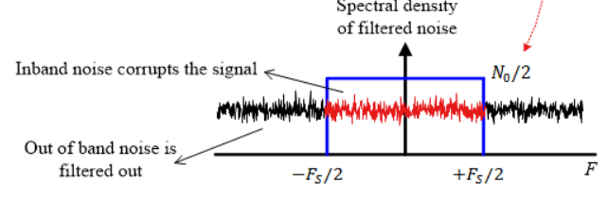
In reality, the ideal flat spectrum from −∞ to +∞ is true for frequencies of interest in wireless communications (a few kHz to hundreds of GHz) but not for higher frequencies.

Slide 7

Signal-to-Noise Ratio
The SNR or S/N is a measure used in science and engineering that compares the level of a desired signal to the level of background noise.
It is defined as the ratio of signal power to the noise power, often expressed in decibels. A ratio higher than 1:1 (greater than 0 dB) indicates more signal than noise.
SNR, bandwidth, and channel capacity of a communication channel are connected by the Shannon–Hartley theorem.

Slide 8

Shannon–Hartley theorem
It states the channel capacity (bits per second) OR information rate of data that can be communicated at low error rate using an average received signal power through communication channel subject to additive white Gaussian noise (AWGN) of power.
where, B is the bandwidth of the channel in hertz.
It is the related to signal-to-noise ratio (SNR) or the carrier-to-noise ratio (CNR) (expressed as a linear power ratio, not as logarithmic decibels).

Slide 9
5 dB - 10 dB: is below the minimum level to establish a connection, due to the noise level being nearly indistinguishable from the desired signal (useful information)
25 dB - 40 dB: is deemed to be good.
41 dB or higher: is considered to be excellent

Slide 10
Mathematics of AM

Slide 11
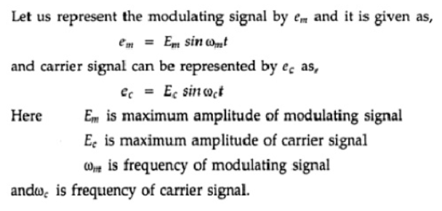

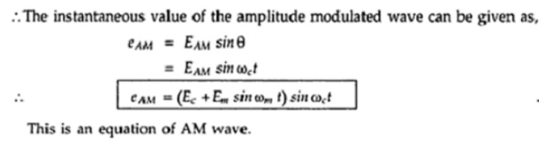

Slide 12
Mathematics of FM

Slide 13

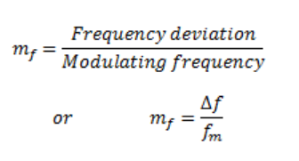
Frequency deviation Δf represents the maximum departure of the instantaneous frequency f_{i}(t) of the FM wave from the carrier frequency f_{c} .

Slide 14
Hands-on Simulation and measurements

Slide 15
Matlab programs
AWGN effect on different functions i.e. sine, cosine, sawtooth.
AM signal under AWGN
AM signal with different SNR values
FM signal under AWGN
FM signal with different SNR values
Use of moving average filter to retrieve the signal by averaging the noise fluctuation.

Slide 16
syntax
out = awgn(in,snr,signalpower)
out = awgn(in,snr)
Adds white Gaussian noise to the vector signal in.

Slide 17



